Slide 1
Email Protocols
Formulating, Sending, & Receiving Email
Notes:
1.5 min

Slide 2
Email Basics
We can generate email objects, either directly or via parsing.
import email, email.message, ssl
msg = email.message.EmailMessage()
msg["From"] = "Prince Johnny Moneybags <prince@bling.com>"
msg["To"] = "Lucky soon-to-be rich person <fake@n.oob>"
msg["Subject"] = "Not, spam, I promise – I'm a prince!"
msg.set_content("I need your help... Account # plz!")
print("***Constructed Email***\n%s" % msg)
raw = ("From: King Johnny Rich <king@bling.com>\n"
"To: Very lucky person <sucker@n.oob>\n"
"Subject: I need your help moving money\n\n"
"Just send me your SSN! You can trust me.\n")
msg = email.message_from_string(raw)
print("***Parsed Email***\n%s" % msg)
with open("backup.eml", "rb") as file:
msg = email.message_from_binary_file(file)
print("***Email from File***\n%s" % msg)
***Constructed Email***
From: Prince Johnny Moneybags <prince@bling.com>
To: Lucky soon-to-be rich person <fake@n.oob>
Subject: Not, spam, I promise – I'm a prince!
…
I need your help... Account # plz!
***Parsed Email***
From: King Johnny Rich <king@bling.com>
To: Very lucky person <sucker@n.oob>
Subject: I need your help moving money
Just send me your SSN! You can trust me.
***Email from File***
From: Emperor Johnny <emperor@bling.com>
To: Super lucky person <pwned@n.oob>
Subject: This is your last chance!
I want to make you rich, but this is it!
Notes:
10 min

Slide 3
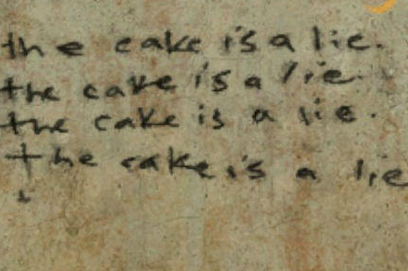
Email Attachments
Python can add attachments and decode them upon receipt.
from email import message_from_bytes, message, policy
msg = message.EmailMessage()
msg["From"] = "Awesome Baker <tasty@bakery.com>"
msg["To"] = "Cake Recipient <cake_eater@zmail.com>"
msg["Subject"] = "Have some cake!"
msg.set_content("I baked it just for you.")
with open("cake.jpg", "rb") as file:
msg.add_attachment(file.read(), filename="cake.jpg",
maintype="image", subtype="jpeg")
data = msg.as_bytes()
…
msg = message_from_bytes(data, policy=policy.default)
for part in msg.iter_attachments():
with open("new-" + part.get_filename(), "wb") as file:
file.write(part.get_payload(decode=True))
Notes:
8.5 min

Slide 4
Sending & Receiving Messages
We can generate email objects and attachments, either directly or via parsing.
import email, imaplib, smtplib, ssl
from email import policy
with open("backup.eml", "r") as file:
msg = email.message_from_file(policy=policy.default)
with smtplib.SMTP("spamserver.lol") as smtp:
smtp.starttls(context=ssl.create_default_context())
smtp.login("prince@bling.com", "dolladollabillyall")
smtp.send_message(msg)
with imaplib.IMAP4_SSL("spamserver.lol") as imap:
imap.login("prince@bling.com", "dolladollabillyall")
imap.select("Inbox")
status, response = imap.search(None, "(UNSEEN)")
msg_ids = [entry.decode() for entry in response.split()]
for msg_id in msg_ids:
flags, msg = imap.fetch(msg_id, "(RFC822)")[1][0]
print(email.msg_from_bytes(msg, policy=policy.default))
To: Emperor Johnny <emperor@bling.com>
From: Gullible Traveler <awesome@sauce.org>
Subject: Intriguing Offer!
Dear Emperor Johnny,
I felt so honored to receive a message from you and for the opportunity to be a part of something bigger than myself – and earn some cash along the way. Please consider me a humble subject. I have provided by SSN and bank account details below; when should I expect the cash to arrive? I promise my buddy a Ferarri and we’d like to go to the shop on Friday to pick it up!
Regards,
Gullible Traveler
P.S. – would you like to visit? I’ll send keys.
Notes:
12.5 min

